Slide 1
Accelerator “Design By Modeling”
Tony Nowatzki

Slide 2
Dark Silicon Problem
Cache
Under ITRS Scaling,
50% Dark Silicon
By 8 nm ?
Core
Core
Core
Core
Esmaeilzadeh et al.
ISCA 2011
Must Reduce or Use Dark Silicon!

Slide 3
Multi Accelerator Design?
Cache
Core
Core
Core
Core

Slide 4
Multi Accelerator Design?
Cache
A1
A1
A1
A1
Dark Silicon Solved?
A2
A3
A2
A3
A2
A3
A2
A3
Core
Core
Core
Core

Slide 5
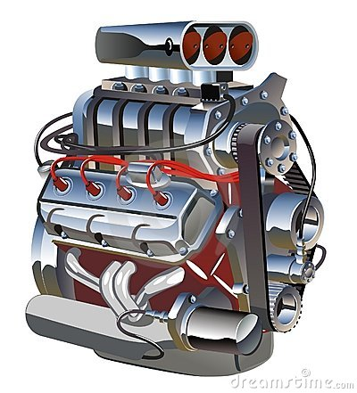
How to design accelerators?
Challenges
General Purpose vs. Specialized?
How do the interact with the core?
What program features do they leverage?
What hardware mechanisms to employ?
How do we get the right set of acccelerators?

Slide 6
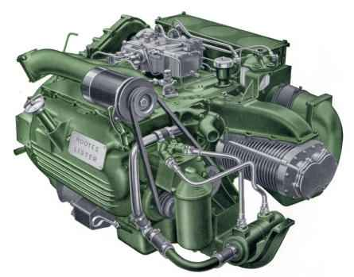
Design in Vacuum
Super-Celerator
Mahlke Motors™
Speedup vs GPP | Super-Celerator
Application 1 | 3x
Application 2 | 9x
Application 3 | 1x
Geo Mean | 3x

Slide 7
Design in Vacuum
Super-Celerator
Mahlke Motors™
Speedup vs GPP | Super-Celerator | SIMD | GPU
Application 1 | 3x | 4x | 1x
Application 2 | 9x | 2x | 100x
Application 3 | 1x | 1x | 1x
Geo Mean | 3x | 2x | 4.6x

Slide 8
Design in Vacuum
Super-Celerator
Mahlke Motors™
Speedup vs GPP | Super-Celerator | SIMD | GPU | Tony-Celerator
Application 1 | 3x | 4x | 1x | 1x
Application 2 | 9x | 2x | 100x | 1x
Application 3 | 1x | 1x | 1x | 3x
Geo Mean | 3x | 2x | 4.6x | 1.4x

Slide 9
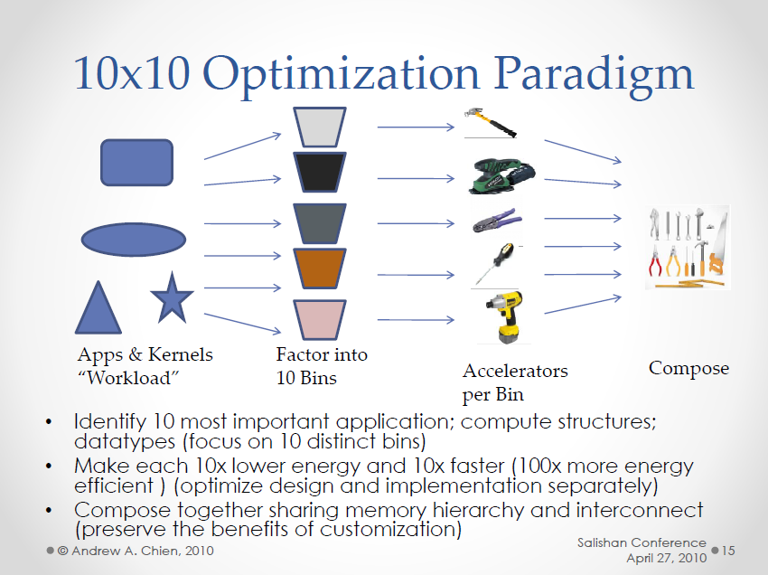
How to Design Accelerators?
Which Bins?

Slide 10
Our Approach: Design By Modeling
Find un-accelerated regions through use of models, and find patterns.
High-Level Design Proposal, and enumerate possible design decisions.
Explore the Design Space, and prune designs that don’t meet performance/energy goals
Iteratively Refine the Design, concretizing elements of the architecture incrementally

Slide 11
Key: Transformable Dependence Graph
Represent programs as trace of micro-architectural events.
Transform this graph to model accelerators.

Slide 12

Magic Version!
Accelerator
Perf/Energy
Lens
Profiler
F
F
F
F
D
D
D
D
Prism
F
F
F
F
D
D
D
D
Simulator (gem5)
F
F
F
F
F
F
F
F
F
F
F
F
F
D
D
D
D
D
D
D
D
D
D
D
D
D
F
F
F
F
D
D
D
D
F
F
F
F
D
D
D
D

Slide 13
Step 1. Find Un-accelerated Regions
Application 1
Application 2
…
Func 1
Loop 1
Loop 2
Func 2
Func 3
Loop 3
Func 4
Accel 1
1.2x
1.1x
Accel 2
0.5x
1x
…
Accel 3
5x
1x
Best:
5x
1.1x
For this study:
Un-accelerated: Performance < 1.3x Better than OOO
73 Un-accelerated Regions Contribute 50% of Cycles

Slide 14
Step 1. Find Un-accelerated Regions
Improve Current Accelerators?
New Accelerator?
SIMD +
Scatter/
Gather?
Simplest Possible Architecture?

Slide 15
Program Structure Breakdown (by % of dynamic instructions)

Slide 16
Step 2. High Level Design Proposal Nested Loop Accelerator (NLA)
For Simplicity, execute only loop structures in the accelerator.
For efficiency, execute with compound functional units.
CFU
ALU
MEM
MPY

Slide 17
Step 2. High Level Design Proposal Nested Loop Accelerator (NLA)
Dynamic Basic Block Trace
BB1
BB2
BB3
BB4
BB4
BB3
BB4
BB4
BB5
Nested Loop

Slide 18
Step 2. High Level Design Proposal Nested Loop Accelerator (NLA)
Dynamic Basic Block Trace
BB1
BB2
BB3
BB4
BB4
BB3
BB4
BB4
BB5
CPU
NLA
CPU
Transfer Register
State &
Configure NLA
Transfer Back
Register State

Slide 19
Step 2. High Level Design Proposal Nested Loop Accelerator (NLA)

Slide 20
Step 3. Design Space Exploration
NLA Design | Practicality | Details
Sequential | Extremely Simple | Each CFU Executes Sequentially Centralized Unit Controls Execution
Pipelined | Practical | CFUs execute in pipelined fashion Central unit manages data deps.
Decoupled | Practical, Needs Design | CFUs execute in dataflow fashion Distributed Issue Queues Software helps disambiguate memory
Speculative OOO | Somewhat Impractical | Speculative Execution w/ Recovery Memory Dependence Prediction

Slide 21
Consider This Architecture
NLA
BERET
C-Cores
GPP
Core
DySER
SIMD

Slide 22
Preliminary Results
NLA Definitely Ineffective
NLA Probably Ineffective
NLA Probably Effective

Slide 23
Step 4: Iteratively Refine Design (Design Everything Else…)
Internal Buffering
Specifics of Interconnection Network
Token Passing Protocol
Mechanism for enforcing memory dependence
Preventing Deadlock
Exception Handling

Slide 24
Conclusions
Design By Modeling
Helps find unexplored opportunities
Iterative TDG modeling based design
Nested Loop Accelerator
Potentially new acceleration domain
Decoupled design looks like a promising target for further exploration

